Slide 1
Mode Analytics Case Study 2: Search Functionality

Slide 2
Problem Statement
The product team at Yammer is interested in determining whether they should work on search functionality and, if so, how they should modify it
Problem Statement 1: Is there a problem with search functionality?
Problem Statement 2: If so, how to fix it?

Slide 3
Solution Steps: Step 1: Identification of user session
SQL Query:
--SQL code to identify each user session. Sessions are tagged different if the time difference between their events is >10 minutes
select sub.*,
case when sub.time is null or sub.time >= interval '10 minute' then sub.sessionid
else 0 end as "sessionno"
from(
select user_id, occurred_at,
occurred_at - LAG(occurred_at, 1) over (partition by user_id order by occurred_at) as "time",
event_name, row_number() OVER () AS "sessionid"
from tutorial.yammer_events
where event_type='engagement'
order by user_id, occurred_at
) sub

Slide 4
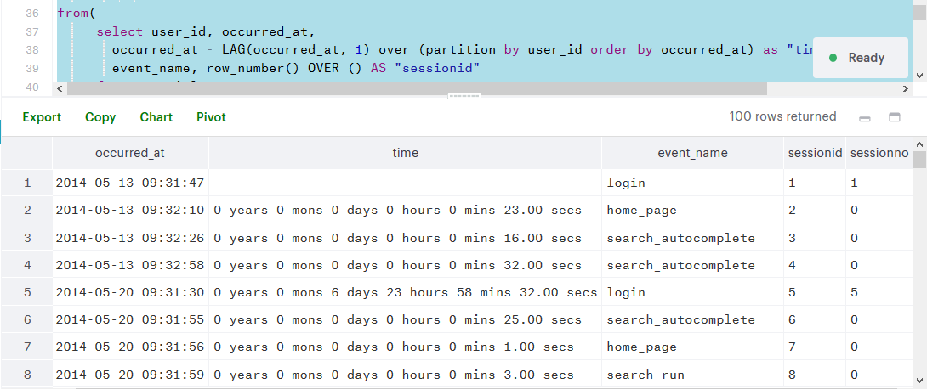
Step 1: Output
Uniquely identified session

Slide 5
Step 2: Tagging each session event with session number
-- Python Code to tag each event against a session
import pandas as pd
#Reading in Data
data=pd.read_csv("C:\\Users\\sudhanshu\\Desktop\\Springboard\\SQL\\CaseStudy2Data.csv")
#Looping over data to tag event names with respective user sessions
for i in range(0,len(data)):
if data.loc[i, 'sessionno']==0:
data.loc[i, 'sessionno'] = data.loc[i-1, 'sessionno']
#Exporting Data
data.to_csv("C:\\Users\\sudhanshu\\Desktop\\Springboard\\SQL\\ResCaseStudy2Data.csv",index = False)

Slide 6
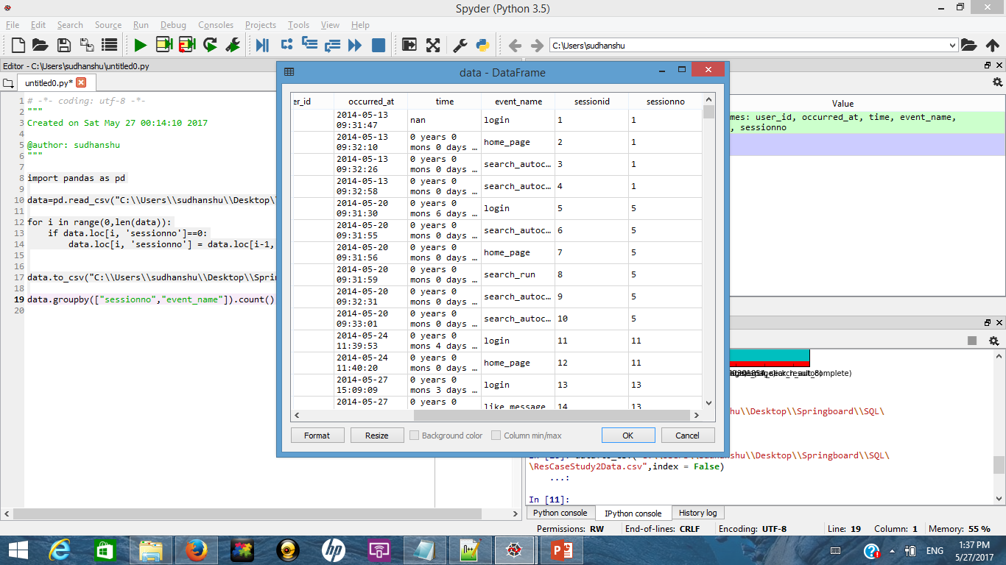
Step 2: Output
Each session event tagged with session number

Slide 7
Step 3: Analysing Search Events per session over time
-- Query for analysing search potency w.r.t total user sessions over time
select sub.date1,
count(distinct(sub.sessionno)) as "TotalNoOfSessions",
SUM(CASE WHEN sub.event_name = 'search_run' THEN sub.total ELSE NULL END) AS "total_search_run",
SUM(CASE WHEN sub.event_name = 'search_autocomplete' THEN sub.total ELSE NULL END) AS "total_search_autocomplete",
SUM(CASE WHEN sub.event_name = 'search_click_result_1' THEN sub.total ELSE NULL END) AS "search_result1_click",
SUM(CASE WHEN sub.event_name = 'search_click_result_2' THEN sub.total ELSE NULL END) AS "search_result2_click",
SUM(CASE WHEN sub.event_name = 'search_click_result_3' THEN sub.total ELSE NULL END) AS "search_result3_click",
SUM(CASE WHEN sub.event_name = 'search_click_result_4' THEN sub.total ELSE NULL END) AS "search_result4_click",
SUM(CASE WHEN sub.event_name = 'search_click_result_5' THEN sub.total ELSE NULL END) AS "search_result5_click",
SUM(CASE WHEN sub.event_name = 'search_click_result_6' THEN sub.total ELSE NULL END) AS "search_result6_click",
SUM(CASE WHEN sub.event_name = 'search_click_result_7' THEN sub.total ELSE NULL END) AS "search_result7_click",
SUM(CASE WHEN sub.event_name = 'search_click_result_8' THEN sub.total ELSE NULL END) AS "search_result8_click",
SUM(CASE WHEN sub.event_name = 'search_click_result_9' THEN sub.total ELSE NULL END) AS "search_result9_click",
SUM(CASE WHEN sub.event_name = 'search_click_result_10' THEN sub.total ELSE NULL END) AS "search_result10_click"
from(
select DATE_TRUNC('day', occurred_at) as "date1",
sessionno,
event_name,
count(event_name) as "total"
from sudhanshu_chib.rescasestudy2data
group by 1,2,3
order by 1
) sub
group by 1

Slide 8
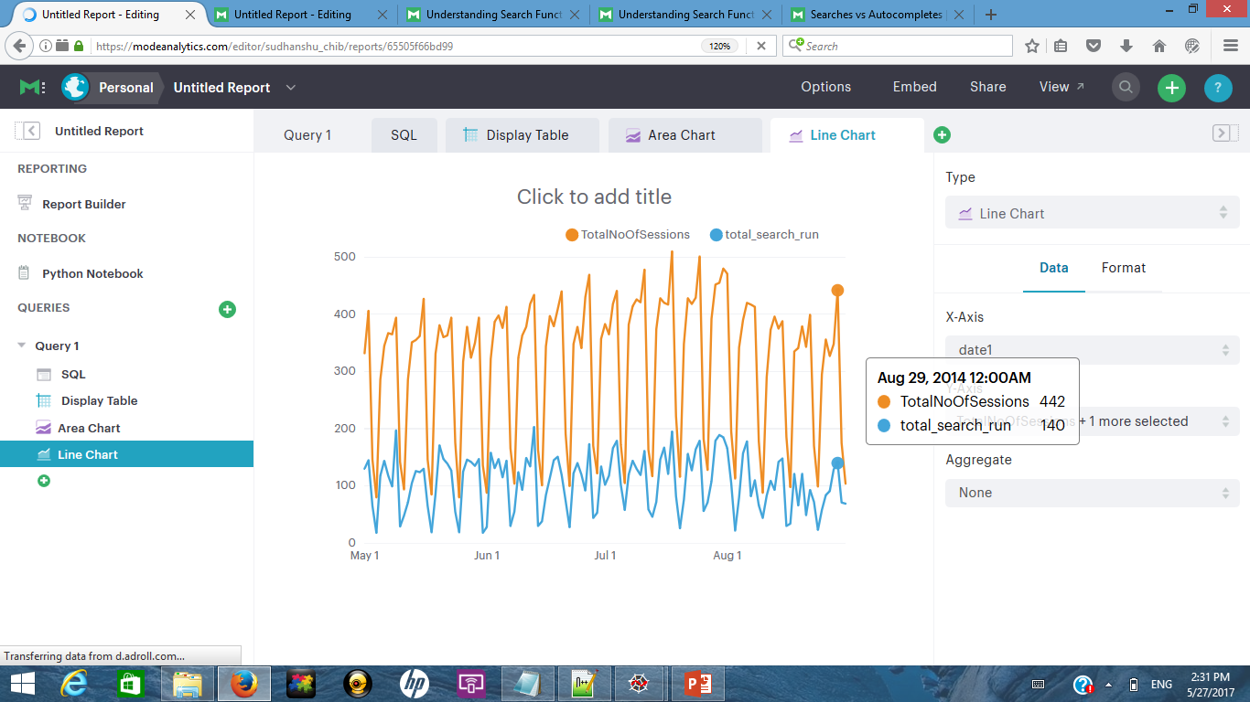
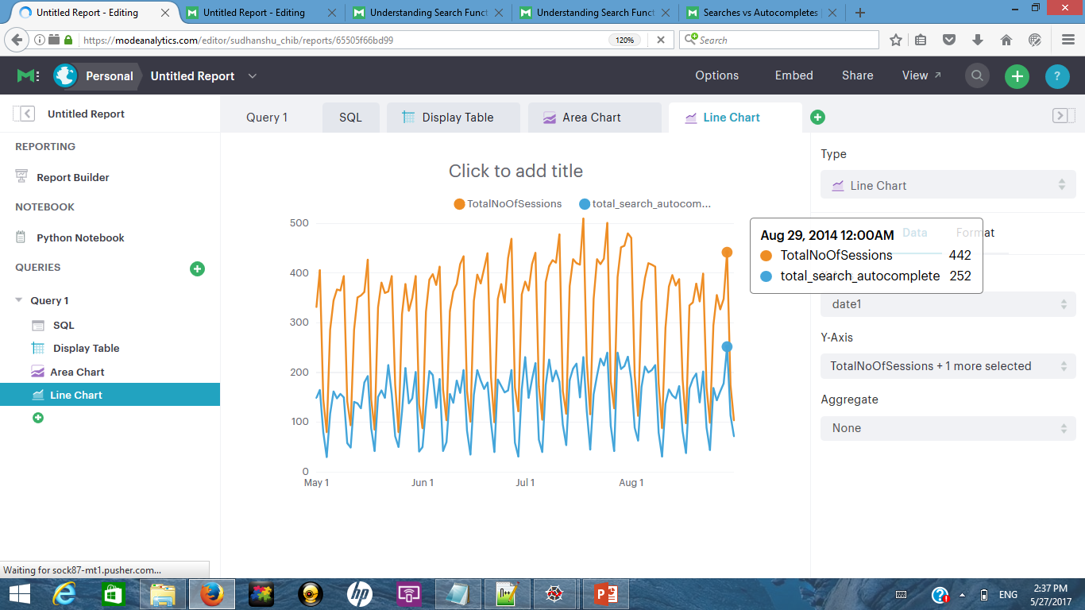
Step 3: Output (1/2)
Number of search_run w.r.t number of total sessions have remained stable over the time period
Number of autocomplete_search w.r.t number of total sessions have also remained stable over the time period

Slide 9
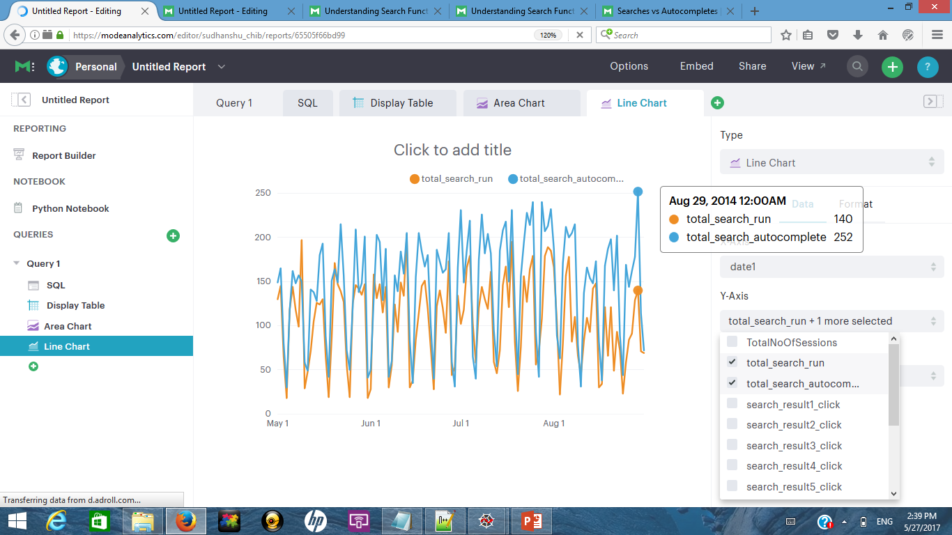
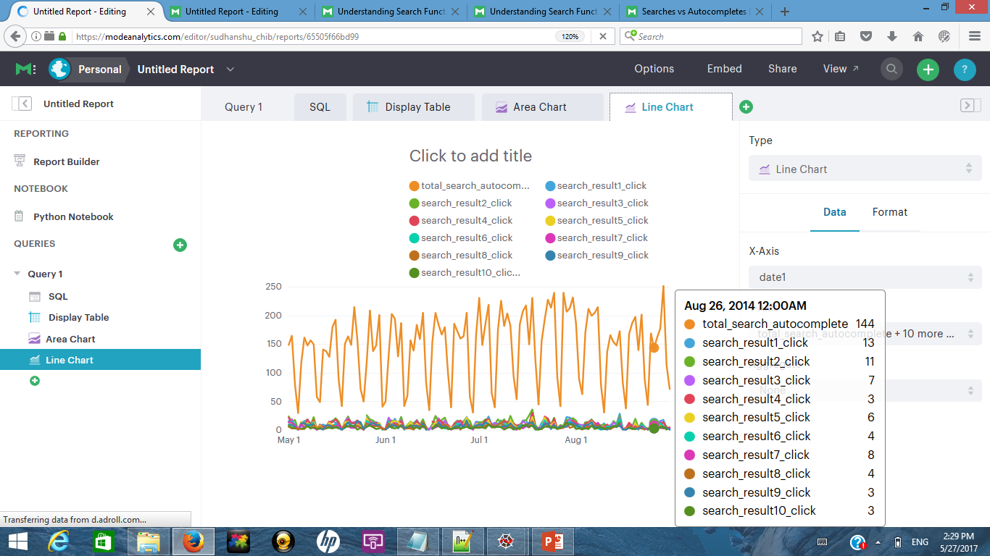
Step 3: Output (2/2)
Number of autocomplete_search have increased w.r.t search_run over the time period
When autocomplete_search is initiated not many results are clicked

Slide 10
Step 4: Finding importance of Search_Run per user session How many session perform 1 or more search_run event
select sub1.date1, sub1.total_search_run, count(sub1.sessionno) as "NoOfSession"
from (
select sub.date1,
sub.sessionno,
SUM(CASE WHEN sub.event_name = 'search_run' THEN sub.total ELSE NULL END) AS "total_search_run",
SUM(CASE WHEN sub.event_name = 'search_autocomplete' THEN sub.total ELSE NULL END) AS "total_search_autocomplete",
SUM(CASE WHEN sub.event_name = 'search_click_result_1' THEN sub.total ELSE NULL END) AS "search_result1_click",
SUM(CASE WHEN sub.event_name = 'search_click_result_2' THEN sub.total ELSE NULL END) AS "search_result2_click",
SUM(CASE WHEN sub.event_name = 'search_click_result_3' THEN sub.total ELSE NULL END) AS "search_result3_click",
SUM(CASE WHEN sub.event_name = 'search_click_result_4' THEN sub.total ELSE NULL END) AS "search_result4_click",
SUM(CASE WHEN sub.event_name = 'search_click_result_5' THEN sub.total ELSE NULL END) AS "search_result5_click",
SUM(CASE WHEN sub.event_name = 'search_click_result_6' THEN sub.total ELSE NULL END) AS "search_result6_click",
SUM(CASE WHEN sub.event_name = 'search_click_result_7' THEN sub.total ELSE NULL END) AS "search_result7_click",
SUM(CASE WHEN sub.event_name = 'search_click_result_8' THEN sub.total ELSE NULL END) AS "search_result8_click",
SUM(CASE WHEN sub.event_name = 'search_click_result_9' THEN sub.total ELSE NULL END) AS "search_result9_click",
SUM(CASE WHEN sub.event_name = 'search_click_result_10' THEN sub.total ELSE NULL END) AS "search_result10_click"
from(
select DATE_TRUNC('day', occurred_at) as "date1",
sessionno,
event_name,
count(event_name) as "total"
from sudhanshu_chib.rescasestudy2data
group by 1,2,3
order by 1
) sub
group by 1,2
)sub1
group by 1, 2
order by 1, 2

Slide 11
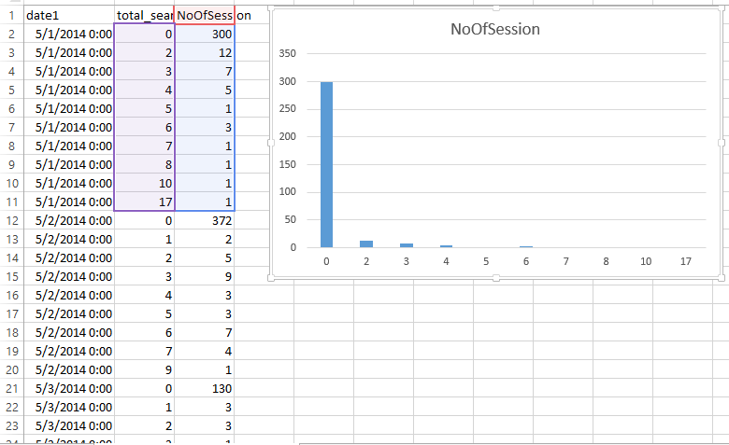
Step 4: Output
Search_Run is evoked in typically 10% of total sessions in a day

Slide 12
Step 5: Finding importance of search_autocomplete per user session How many session perform 1 or more search_autocomplete event
select sub1.date1, sub1.total_search_autocomplete, count(sub1.sessionno) as "NoOfSession"
from (
select sub.date1,
sub.sessionno,
SUM(CASE WHEN sub.event_name = 'search_run' THEN sub.total ELSE NULL END) AS "total_search_run",
SUM(CASE WHEN sub.event_name = 'search_autocomplete' THEN sub.total ELSE NULL END) AS "total_search_autocomplete",
SUM(CASE WHEN sub.event_name = 'search_click_result_1' THEN sub.total ELSE NULL END) AS "search_result1_click",
SUM(CASE WHEN sub.event_name = 'search_click_result_2' THEN sub.total ELSE NULL END) AS "search_result2_click",
SUM(CASE WHEN sub.event_name = 'search_click_result_3' THEN sub.total ELSE NULL END) AS "search_result3_click",
SUM(CASE WHEN sub.event_name = 'search_click_result_4' THEN sub.total ELSE NULL END) AS "search_result4_click",
SUM(CASE WHEN sub.event_name = 'search_click_result_5' THEN sub.total ELSE NULL END) AS "search_result5_click",
SUM(CASE WHEN sub.event_name = 'search_click_result_6' THEN sub.total ELSE NULL END) AS "search_result6_click",
SUM(CASE WHEN sub.event_name = 'search_click_result_7' THEN sub.total ELSE NULL END) AS "search_result7_click",
SUM(CASE WHEN sub.event_name = 'search_click_result_8' THEN sub.total ELSE NULL END) AS "search_result8_click",
SUM(CASE WHEN sub.event_name = 'search_click_result_9' THEN sub.total ELSE NULL END) AS "search_result9_click",
SUM(CASE WHEN sub.event_name = 'search_click_result_10' THEN sub.total ELSE NULL END) AS "search_result10_click"
from(
select DATE_TRUNC('day', occurred_at) as "date1",
sessionno,
event_name,
count(event_name) as "total"
from sudhanshu_chib.rescasestudy2data
group by 1,2,3
order by 1
) sub
group by 1,2
)sub1
group by 1, 2
order by 1, 2

Slide 13
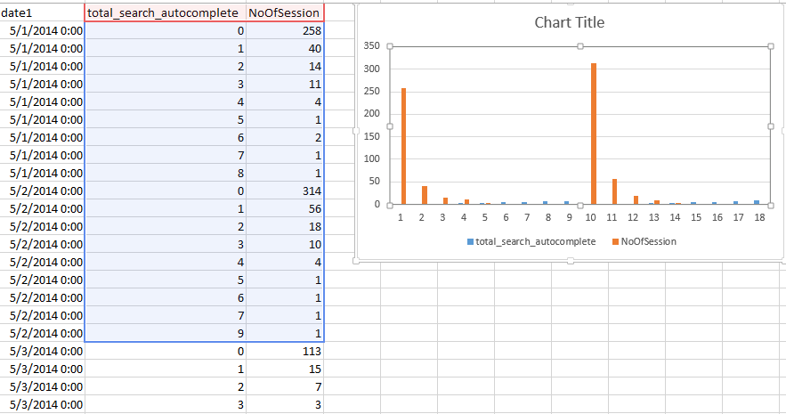
Step 5: Output
Autocomplete_search is evoked in typically 26% of total sessions in a day

Slide 14
Insights and Recommendation:
Search_Run and Autocomplete_Search are important functionality of the Yammer application as they are part of approx. 26% and 10% sessions respectively
Use of Autocomplete_Search has increased over Search_Run over the time period but not many users are clicking the results shown by autocomplete_search
Identified problem area:
a. Search_Run functionality is losing ground indicating users are not finding it useful
b. Autocomplete_Search is being frequently used but users don’t tend to click on the subsequent
search results
Recommendation:
Improve the search algorithm for search_autocomplete so that more important results are displayed
upfront resulting in user clicks
b. Search_Run functionality is losing ground and its algorithm needs to be upgraded

Slide 15
Problem with Mode Analytics Solution
The logic used by mode analytics in their query to identify a user session will work only if the session ends with a search. So if in a session a user after login performs a search run or triggers an auto complete search and proceeds to like or click a message then all the intermediate search steps are lost.
Hence the solution posted on the website will not be completely correct
The same is highlighted in the next slides:

Slide 16
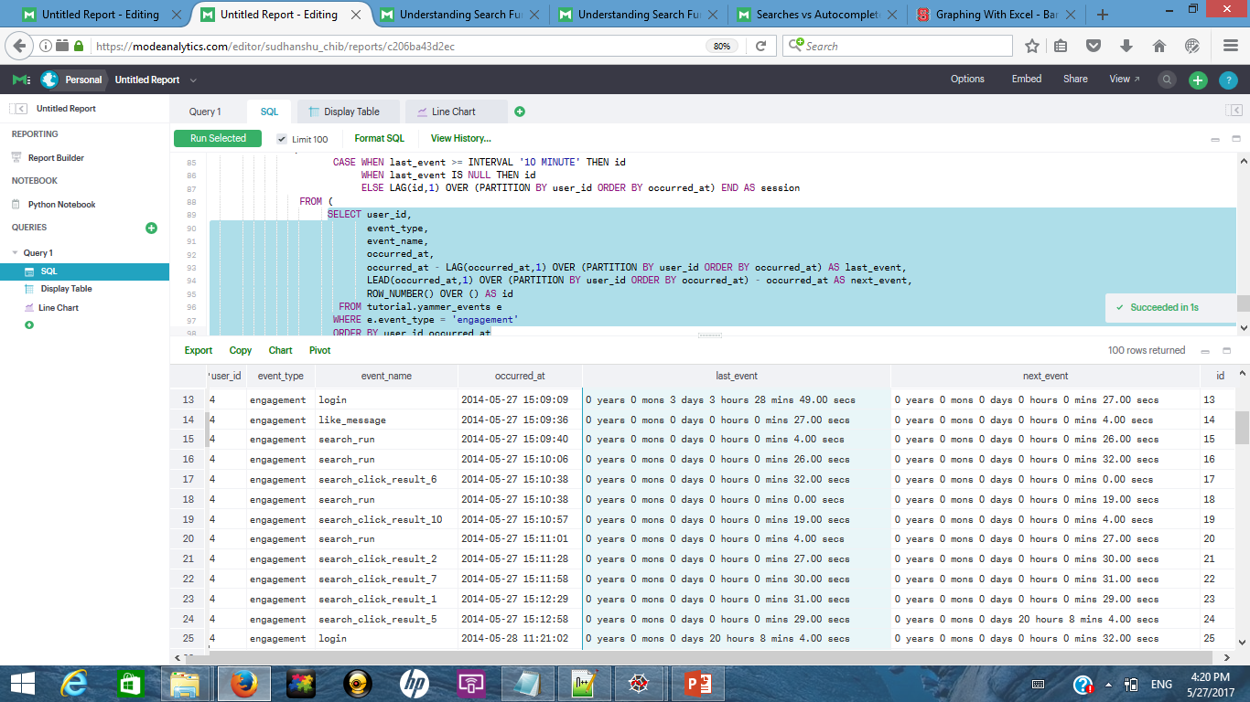
Problem with Mode Analytics Solution
One session details

Slide 17
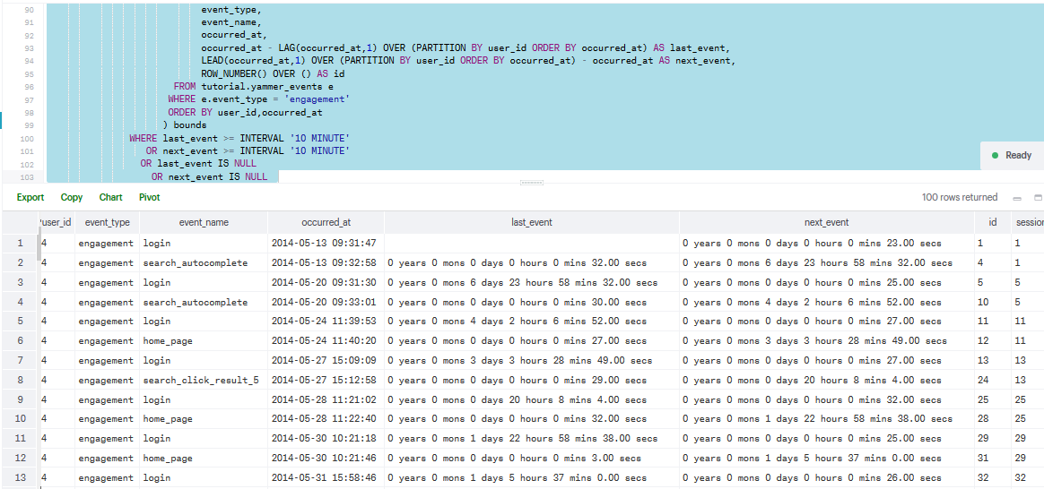
Problem with Mode Analytics Solution
Cause of error
Details captured by mode query:
Lot of search events are lost

